Slide 1
Intense observations of RR Lyr stars
Dr. F.-J. (Josch) Hambsch
VVS, GEOS, BAV, AAVSO

Slide 2
Interest in RR Lyr stars
RR Lyr stars are old stars with about 0.7 M_{sun}
Red giants with Helium core burning
Radial pulsators with less than 1 day period
Light curve changes of 1 mag and more
Light curve shape different for RRab and RRc Lyr stars
Many RR Lyr stars show additional variability called Blazhko effect

Slide 3
Observatory in Mol, Belgium
Several scopes
CCD with BVRI photometric filters
Usage each clear night (if at home)

Slide 4
Remote Observatory in New Mexico
50cm RC f/8.4 (4200mm FL)
STL11K with BVI photometric filters
New Mexico Skies (altitude about 2400m)
UT + 7h
Shared usage

Slide 5
AAVSO scope K28 and other non AAVSO scopes at Astrokolkhoz site

Slide 6
ROAD: Remote Observatory Atacama Desert
San Pedro de Atacama
2450 m above sealevel
5000 inhabitants
Electricity, Water, Lodging, Food, Shops
High speed (4MB and more) internet
+ 300 clear nights / year
Southern Hemisphere (23 deg south)
Competent people for service
Dark sky 22.00 mag/sq arcsec

Slide 7
ROAD during setup
40 cm f/6.8 ODK Orion Optics with FLI ML16803 CCD

Slide 8
ROAD in action
Courtesy Y. Beletsky

Slide 9
ROAD All Sky camera during full moon

Slide 10
ROAD in numbers
Starting regular observations Aug. 1, 2011
Clear nights (Aug 2011-July 2012 = 320)
2012 = 319, 2013 so far more than 140
Number of clear nights = observed nights

Slide 11
Some RR Lyr observed intensively mainly from Northern Hemisphere
NU Aur, VY CrB, DY And, CX Lyr,

Slide 12
NU Aur
E = 2455087.44 HJD
P = 0.53940 +/- 0.00002 d
Blazhko Effect !!

Slide 13
NU Aur
Blazhko period
114.7 d

Slide 14
VY CrB
E = 2455602.945 HJD
P = 0.46296 +/- 0.00008 d
Blazhko Effect !!

Slide 15
VY CrB
Blazhko period
33.4 d

Slide 16
DY And
E = 2455470.615 HJD
P = 0.5965 +/- 0.013 d
Blazhko Effect !!

Slide 17
DY And
Blazhko period
224.8 d

Slide 18
CX Lyr
Blazhko period
68.04 d

Slide 19
Data mainly from ROAD Chile
V354Vir, AL Pic, V1820 Ori, V784 Oph

Slide 20
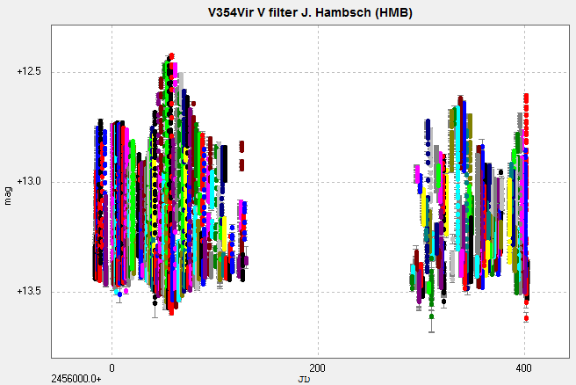
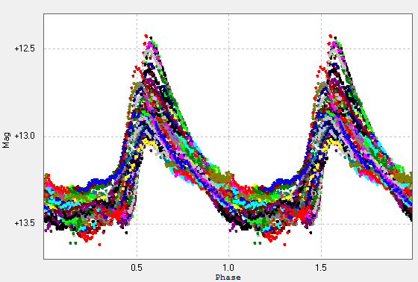
V354Vir 2012-13

Slide 21
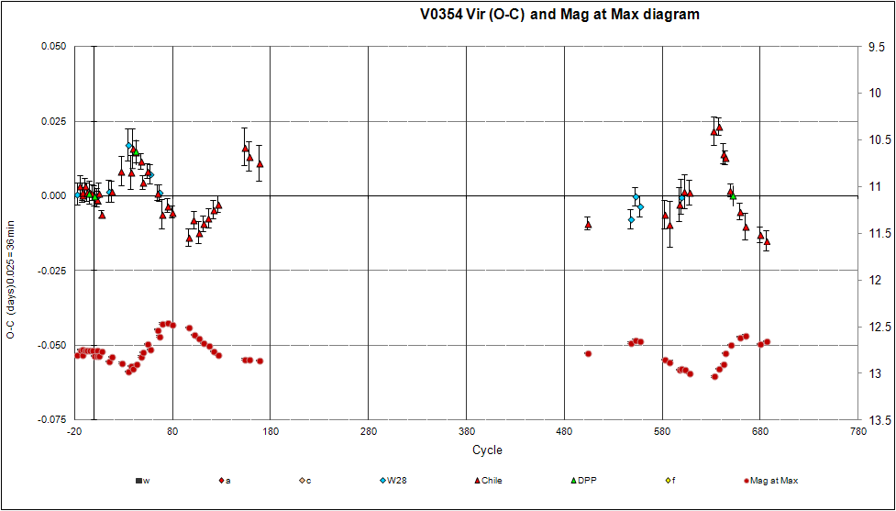
V354 Vir
Blazhko period
88.7 d

Slide 22
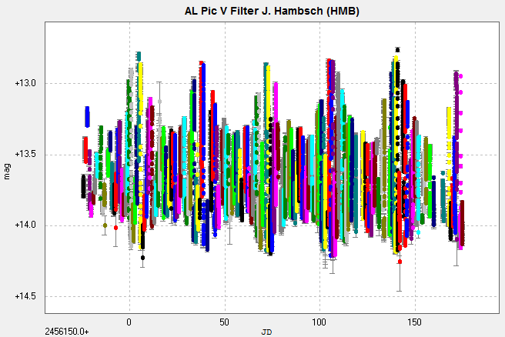
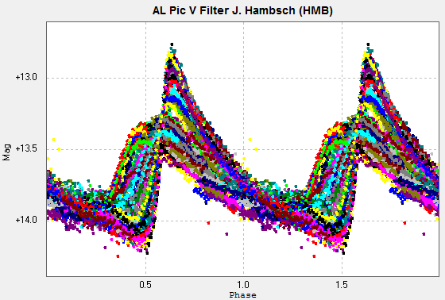
AL Pic

Slide 23
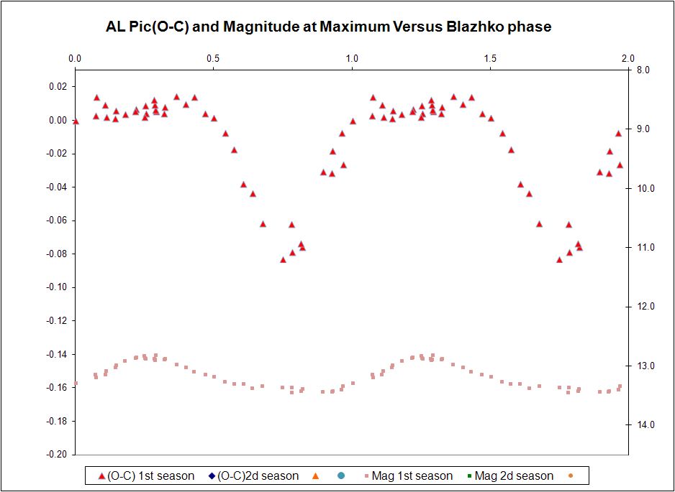
AL Pic
Blazhko period
32.4 d

Slide 24
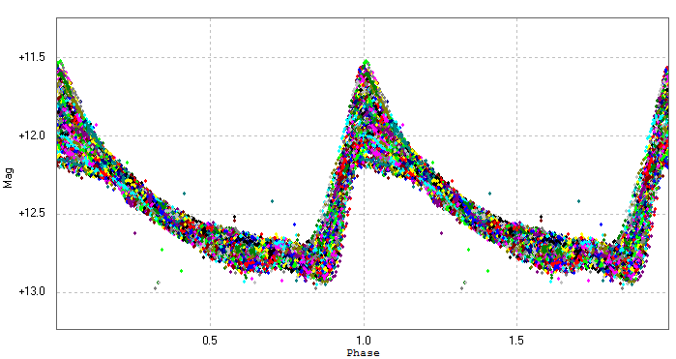
V784Oph
E = 2456047.7942 HJD
P = 0.6033557 +/- 0.0000078d

Slide 25
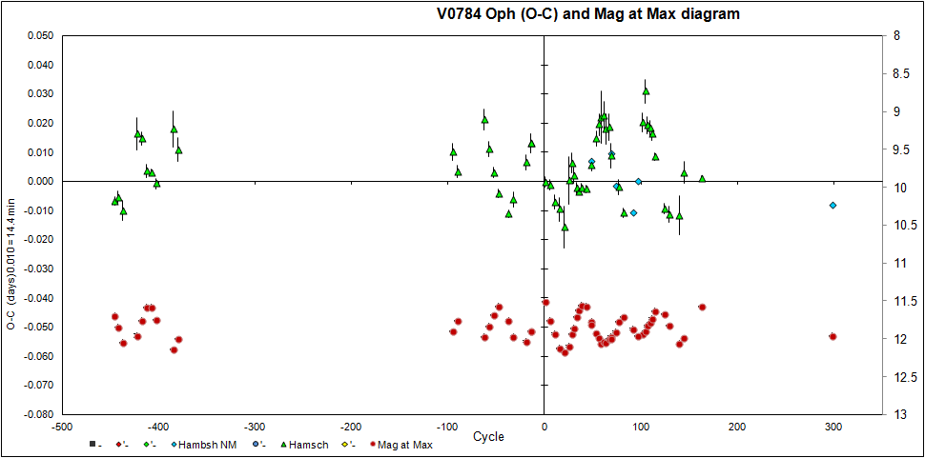
V784Oph
Blazhko periods 24.51 d and 34.70 d

Slide 26
V1820 Ori
V1820 Ori is a RR Lyrae star of type RRab
Period: (0.479078 +/- 0.000032) d
Strong Blazhko effect
Blazhko amplitude modulation of 0.85 mag
Blazhko phase modulation 30% of pulsation period
Blazhko period: 27.89 d
Variable Blazhko period!!

Slide 27
GSC0125-0449 New Mexico

Slide 28
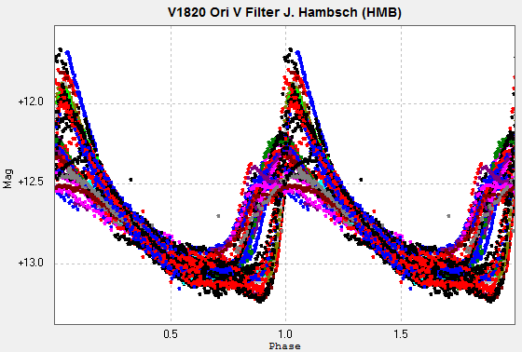
Strong Blazhko effect
ROAD 2011/2012
New Mexico 2007/2008

Slide 29
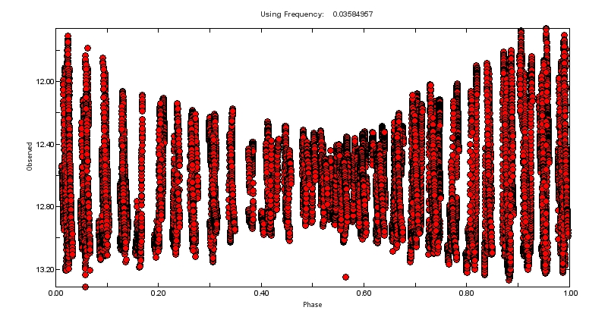
Blazhko cycle coverage
Blazhko period: 27.89 days

Slide 30
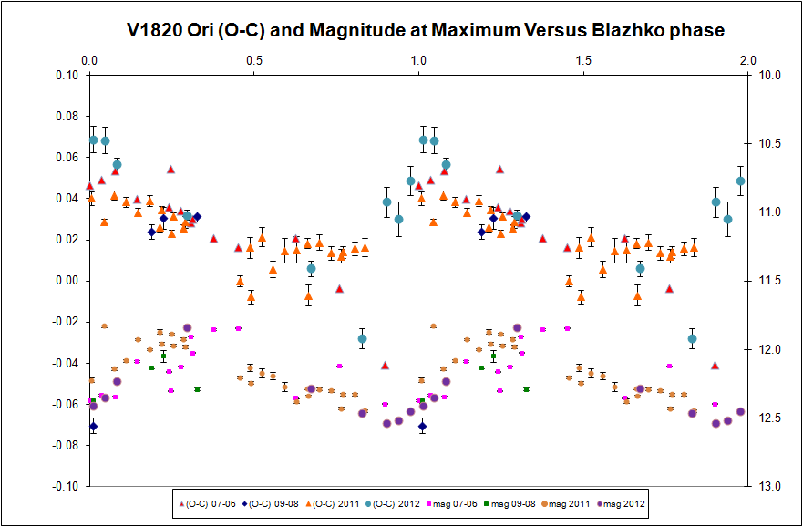
Blazhko cycle coverage
Blazhko period: 27.89 days

Slide 31
Publications
de Ponthière et al., JAAVSO 40, 2012, GEOS RR Lyrae Survey: Blazhko Period Measurement of Three RRab Stars—CX Lyrae, NU Aurigae, and VY Coronae Borealis
de Ponthiere et al., JAAVSO 41, 2013, V1820 Orionis: an RR Lyrae Star With Strong and Irregular Blazhko Effect
More to come

Slide 32
The end Thank you for your attention

